Slide 1

Dengue Prediction
W205 Project Proposal
Felipe Campos
Frank Shannon
Josh Wilson
Matthew Holmes
July 18, 2017

Slide 2
What is Dengue and Why is it important?
Dengue fever is a mosquito-borne viral tropical disease
Aedes aegypti female is primary vector
Humans and lower primates are reservoirs for virus
Endemic in 110 countries between latitudes 35 N and 35 S (equatorial)
50 to 528 million cases per year
Case numbers increases due to urbanization and global warming
Virus types - DENV 1 - 5
Dengue fever types
Uncomplicated (80 - 90%)
  Incubation period: 3 - 10 days after bite
  High fever + aches (muscle & joint) + rash
  Spontaneous recovery
Severe (5 - 10%)
  Usually infected with different virus type
  Hemorrhage due to low platelet count
  Shock Syndrome (1 - 5%) - fatal
Prevention
Integrated vector control
  Eliminate mosquito habitats
  Guppy colonies to eat larvae
  Public warnings about high mosquito counts
2. Vaccination: pending approval
3. Anti-viral drugs

Slide 3
Goals and Data Needed
Goals
Core Functionality
  Predict the number of cases of dengue/week in each location: Iquitos, Peru and San Juan, PR
Extra Functionality
  Predict other diseases also carried by the Aedes Aegypti mosquito such as Zika
  Prediction for additional geographical areas
  Continuous real-time predictions from our app
Data Needed
Core Dataset
  Weather related variables:
    Temperature, Precipitation, Dew Point, Humidity, Air Temperature (Max/Min/Avg/Range/Sum)
Extra Dataset
  Topographic Variables
    Altitude, Terrain,
  Demographic Variables
    Socioeconomics, Density, Income, Mobility, Healthcare

Slide 4
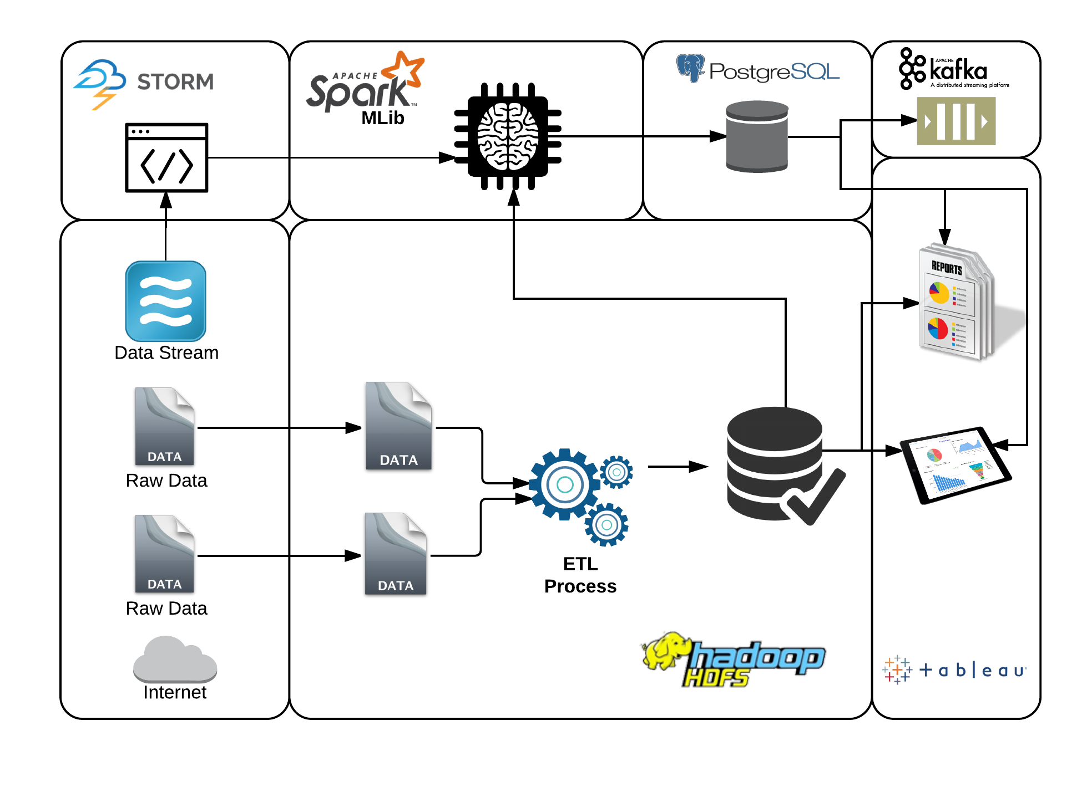
Data Architecture

Slide 5
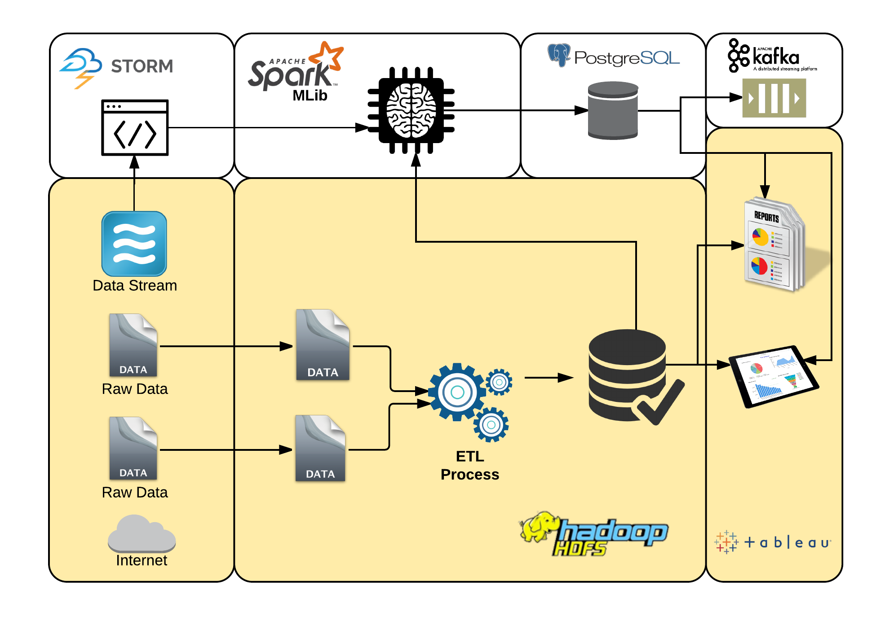
Data Architecture - Implementation Phase 1

Slide 6
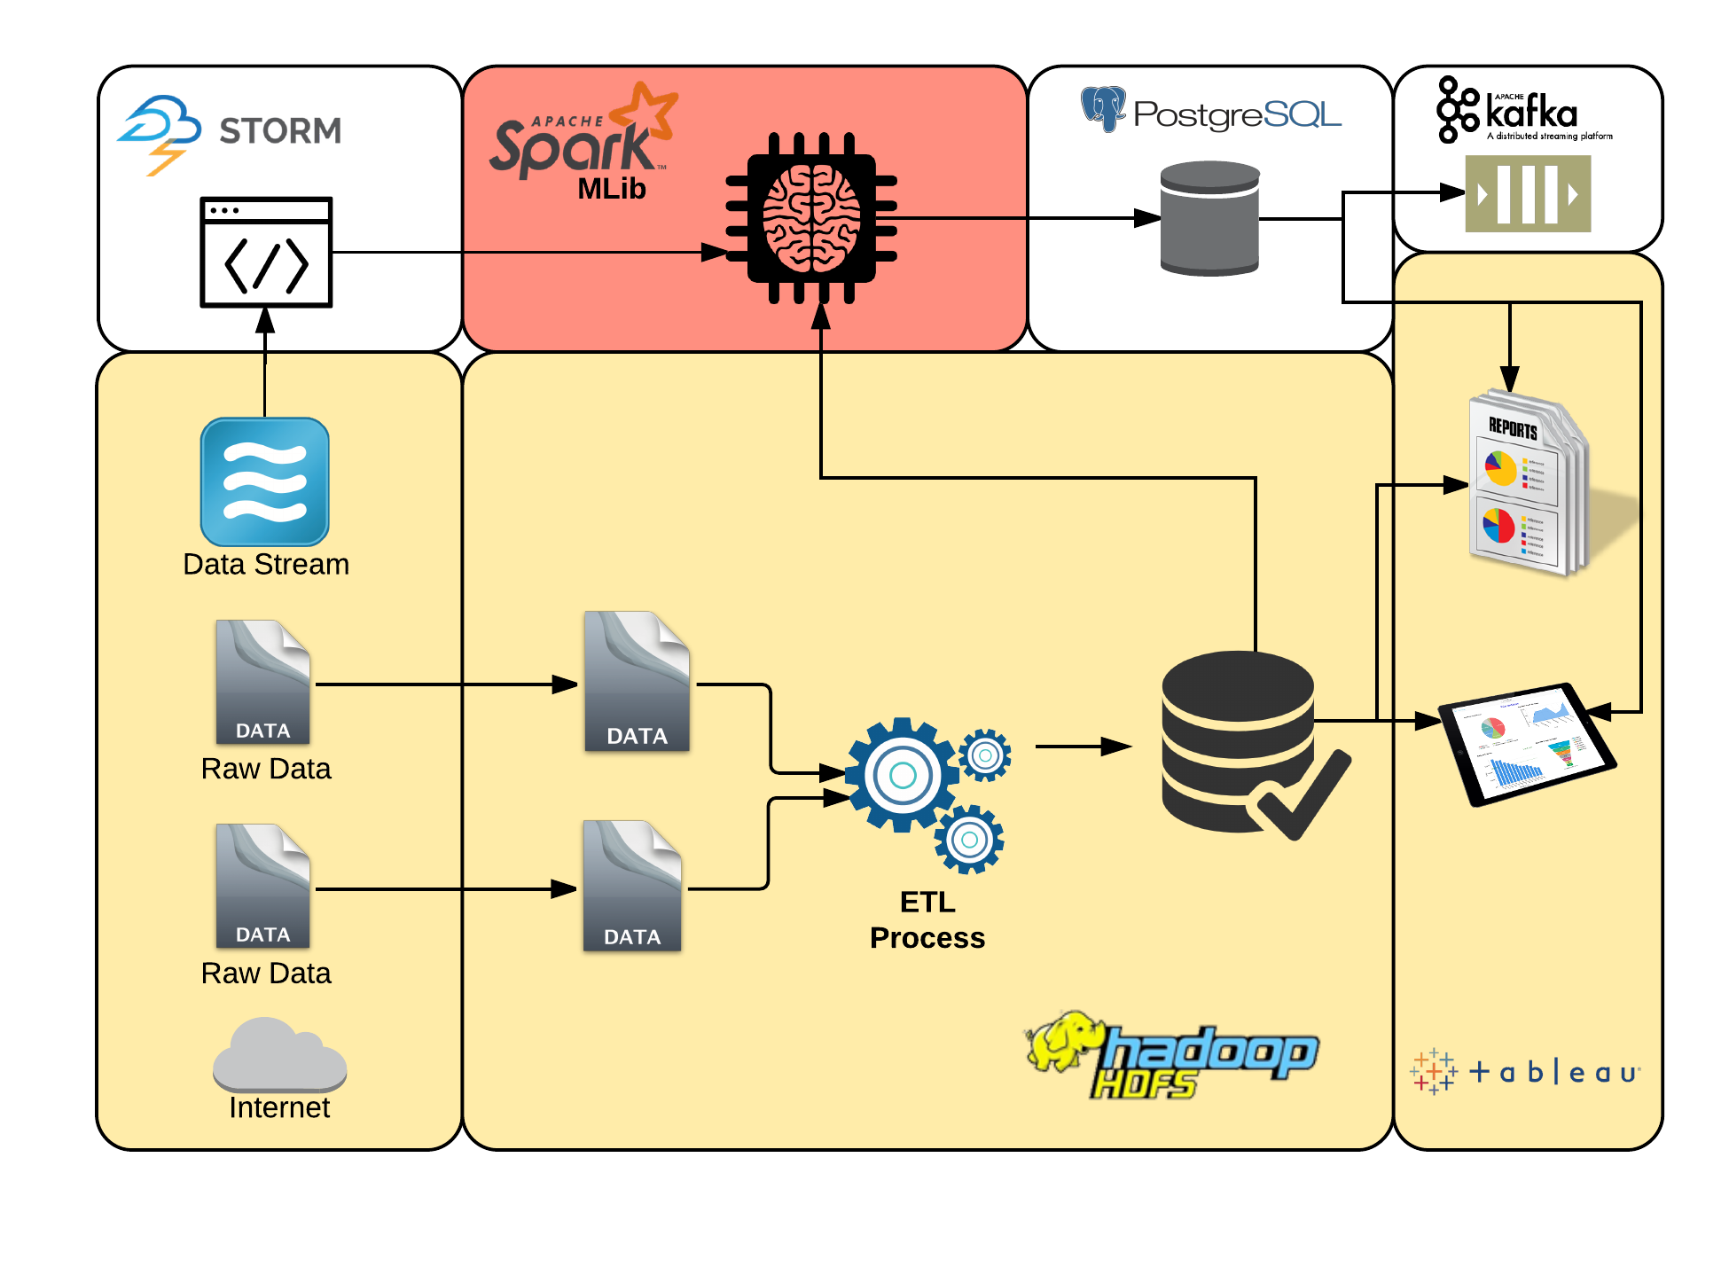
Data Architecture - Implementation Phase 2

Slide 7
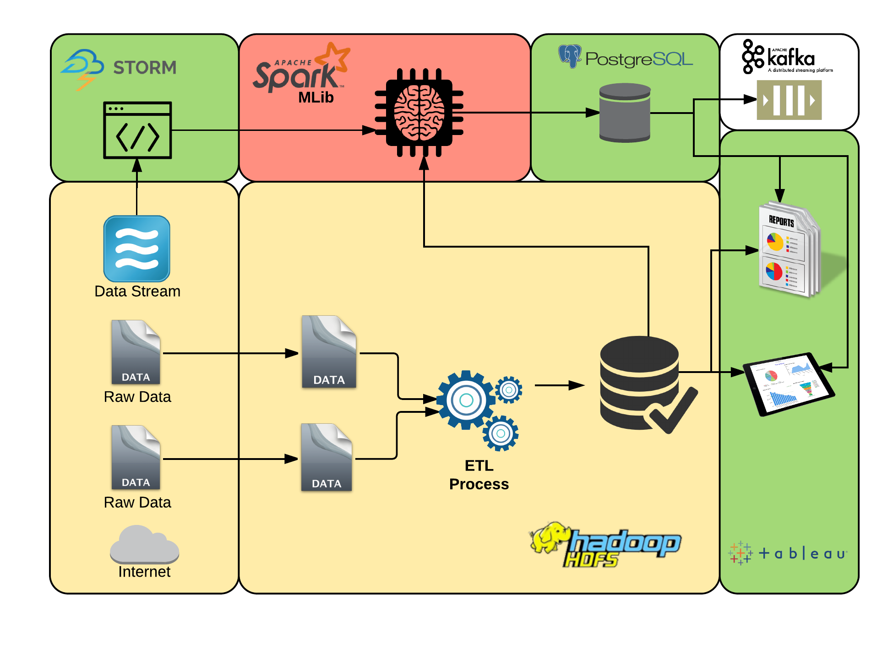
Data Architecture - Implementation Phase 3

Slide 8
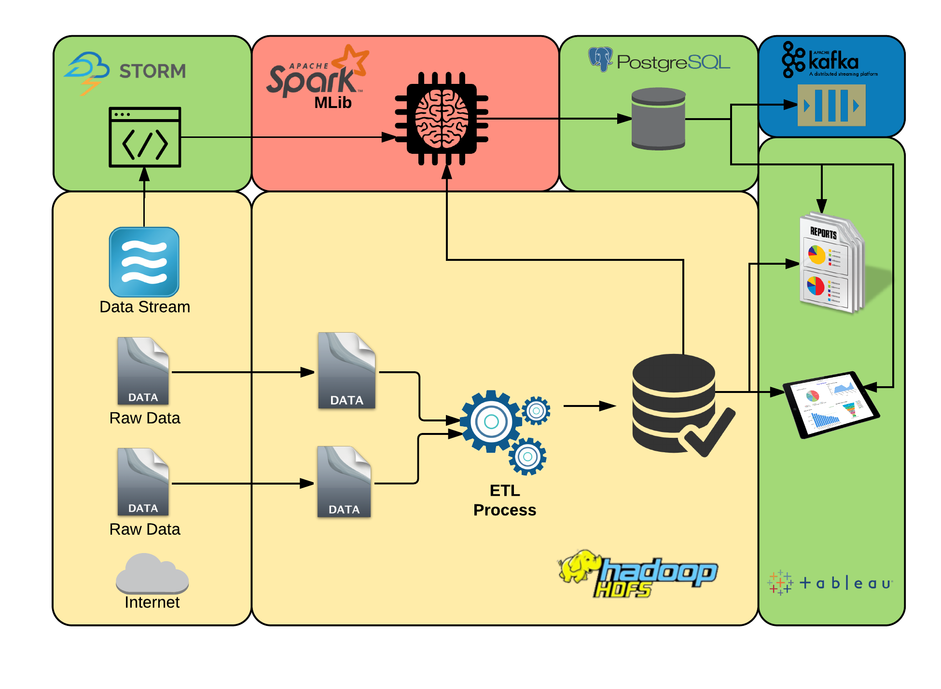
Data Architecture - Implementation Phase 4

Slide 9

Final Product: ML informing Public Health Officers
Problem Structure:
Regression Problem: predict number of cases
Ordered Events: time matters
Potential Models:
Multivariate Time Series: baseline (ts-flint)
Ensemble Method using sliding window method (mllib)
HMM (no known package)
Output:
Trend Lines: number of cases over time with predicted future cases
Map Viz: progression of infection over time, identification of risk area

Slide 10
Thank You!

